Slide 1
The Fall of Lytro

Slide 2
AGENDA
The Genesis
What is Light-Field Photography?
The Hype and the First Product
The Cracks begin to Show
The Second Attempt
The Pivot and the End

Slide 3
The Genesis

Slide 4

The Genesis
The story of Lytro begins with its founder, Ren Ng, a gifted researcher at Stanford University. For his Ph.D. dissertation in computer science, Ng tackled a concept that had been theoretical for nearly a century: light-field photography.
This Photo by Unknown Author is licensed under CC BY-ND

Slide 5
What is Light-Field Photography?

Slide 6
What is Light-Field Photography?
Capture only the intensity and color of light. The focus is permanently locked the moment you take the picture.
A light-field camera also captures the DIRECTION of every light ray, using a special microlens array placed over the sensor.
This wealth of data allows the user to choose the focal point after the photo has already been taken.
This technology was developed by Ren Ng based on his award-winning 2006 dissertation, leading him to found the company Lytro.

Slide 7
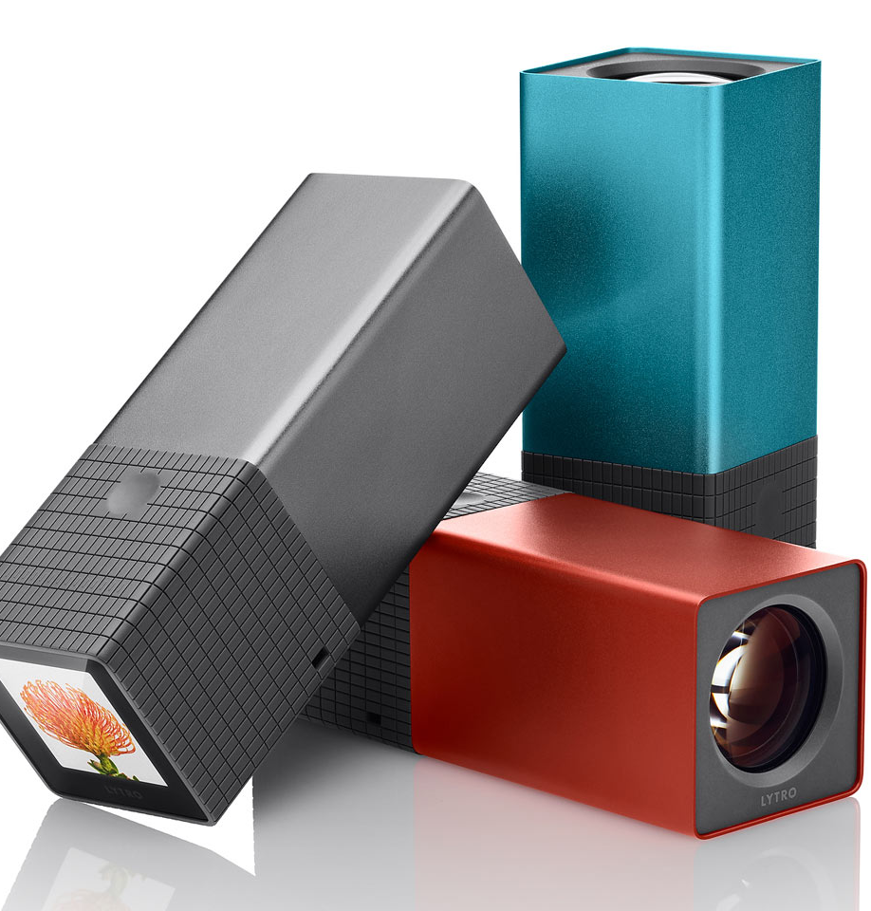
The Hype and the First Product

Slide 8
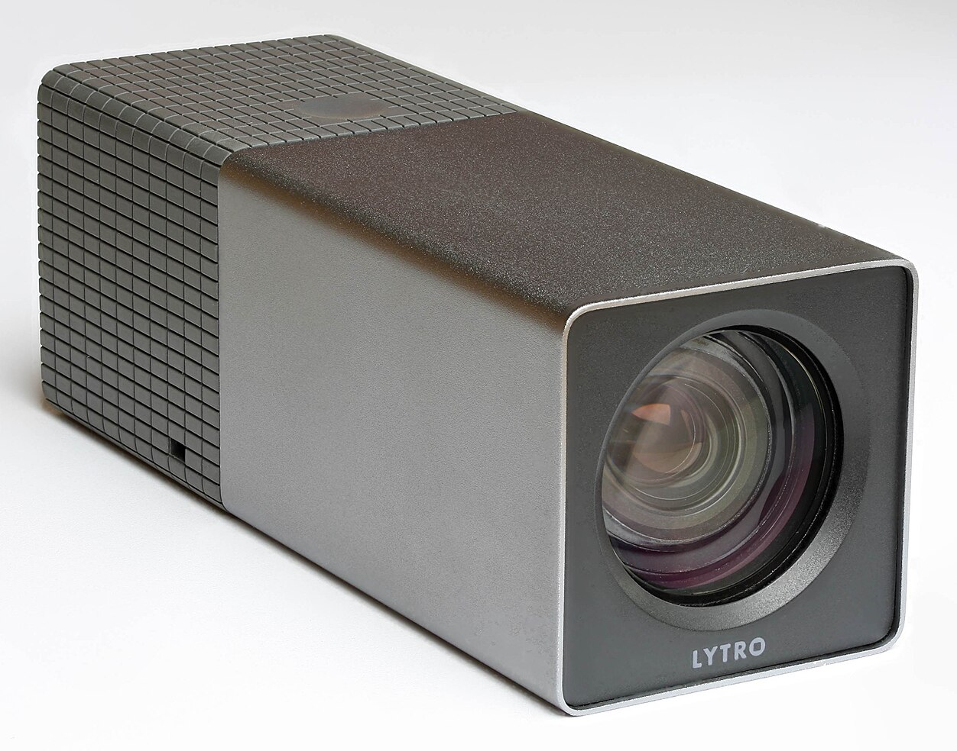
The Hype and the First Product
In 2012, Lytro released its first product: the Lytro Light Field Camera. It was unlike any camera anyone had seen before.
Design: It was a small, rectangular tube, like a kaleidoscope or a small telescope. One end had the lens, the other had a tiny 1.5-inch touchscreen.
The "Living Pictures": The images it produced were interactive. You could click on different parts of the picture on a screen to change the focus, creating a "living picture."
Technology: It measured its sensor's resolution in "Megarays"—the number of light rays it could capture (11 Megarays for the first model).
However, the magic trick of post-capture refocusing came with significant trade-offs that quickly became apparent.

Slide 9
The Cracks begin to Show

Slide 10
The Cracks begin to Show
Abysmal Image Quality: While it captured 11 "Megarays," the final 2D image you could export was a paltry 1.2 megapixels (1080x1080). In an era when even smartphones were boasting 8 megapixels and higher, this was a massive step backward. The images were only suitable for online sharing, not for printing.
Awkward Ergonomics: The tube-like design was weird and unconventional. It was difficult to hold steady and lacked the familiar feel of a camera.
Proprietary Ecosystem: The "living pictures" were locked into Lytro's proprietary software and web platform. Sharing them on social media was clunky, and you couldn't easily edit them in standard software like Adobe Photoshop.
A Gimmick, Not a Must-Have: The core feature—refocusing—was a cool party trick. But for most photographers, both amateur and professional, it didn't solve a pressing problem. Most people had become adept enough at focusing, especially with the rise of autofocus and touchscreen focusing on phones.
High Price: At $399-$499, it was an expensive novelty item that delivered lower-quality images than cameras and phones that cost less.

Slide 11
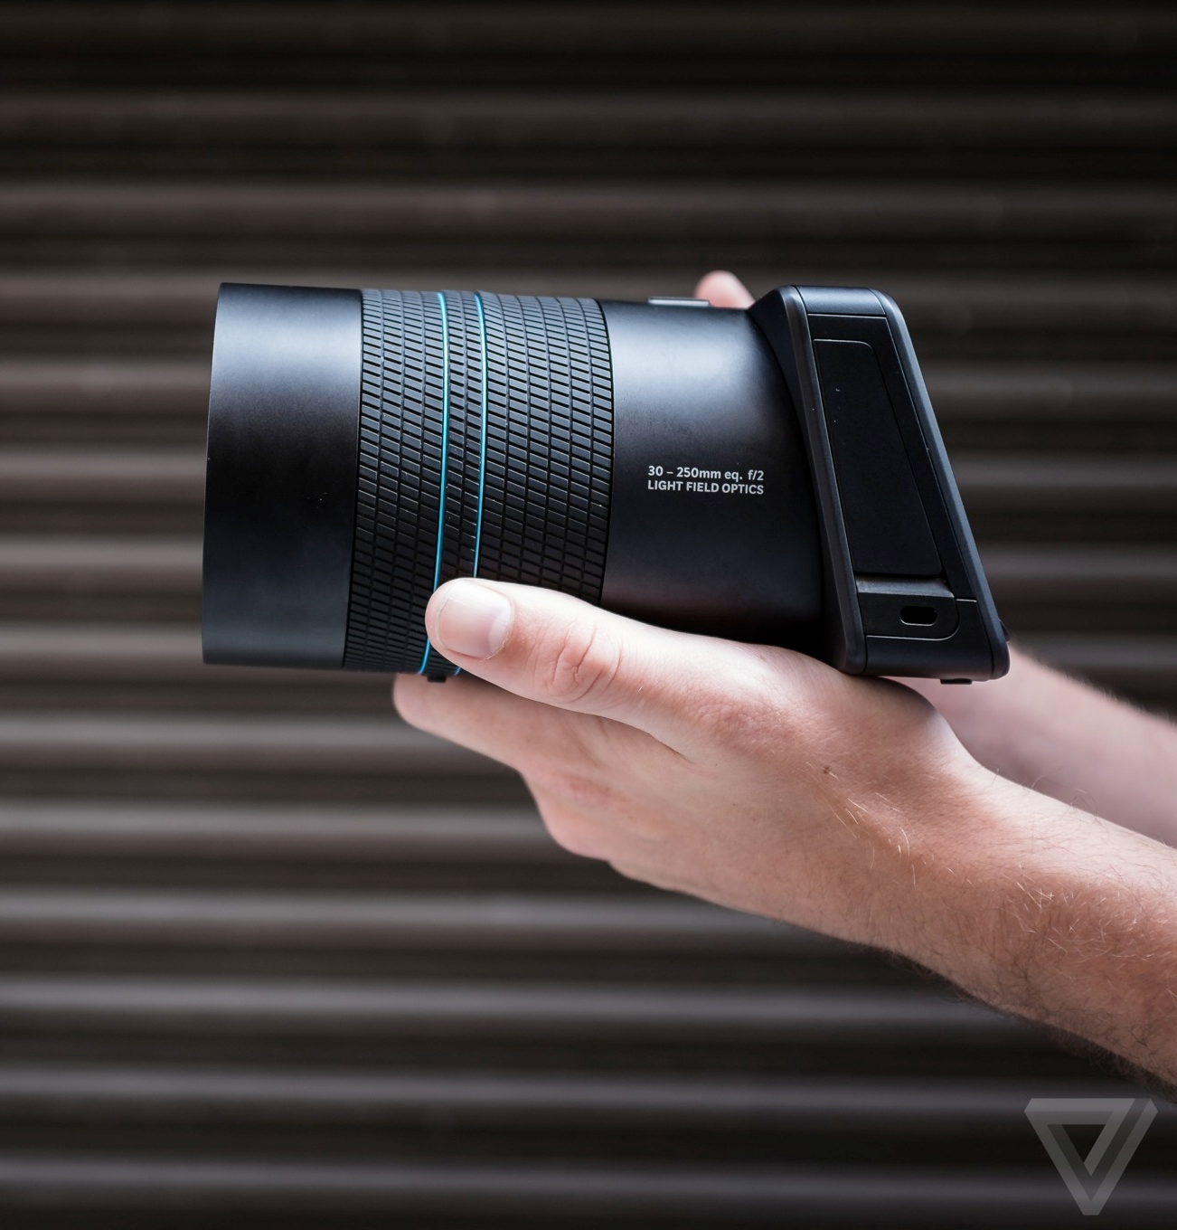
The Second Attempt

Slide 12
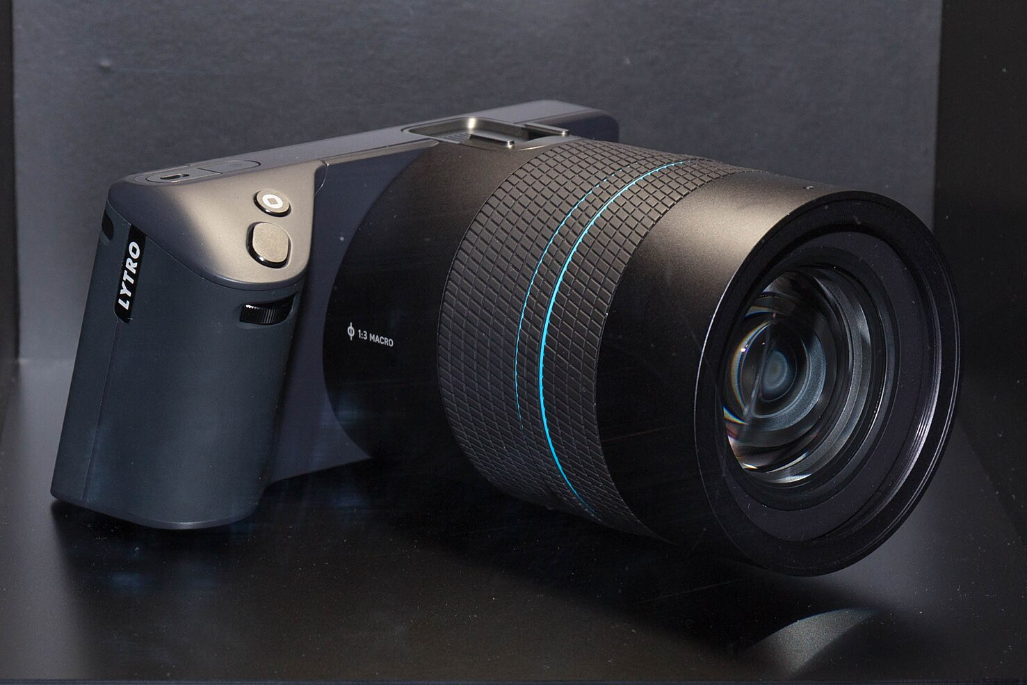
The Second Attempt
Lytro learned from its mistakes and aimed its second product at a more serious, professional market. In 2014, they launched the Lytro Illum.
Design: This looked much more like a modern, high-end mirrorless camera with a large lens, a proper grip, and an articulated screen.
Improved Sensor: It boasted a 40 Megaray sensor, which could produce a more respectable 4-megapixel final 2D image.
Price: It was launched at a hefty $1,600, placing it firmly in the "prosumer" and professional market.
While the Illum was a significant improvement and a more serious photographic tool, it still failed to gain traction. The core problems remained: the resolution was still too low for professional work, the workflow was still cumbersome, and it was a niche product in a market dominated by high-resolution DSLR.

Slide 13
The Pivot and the End

Slide 14
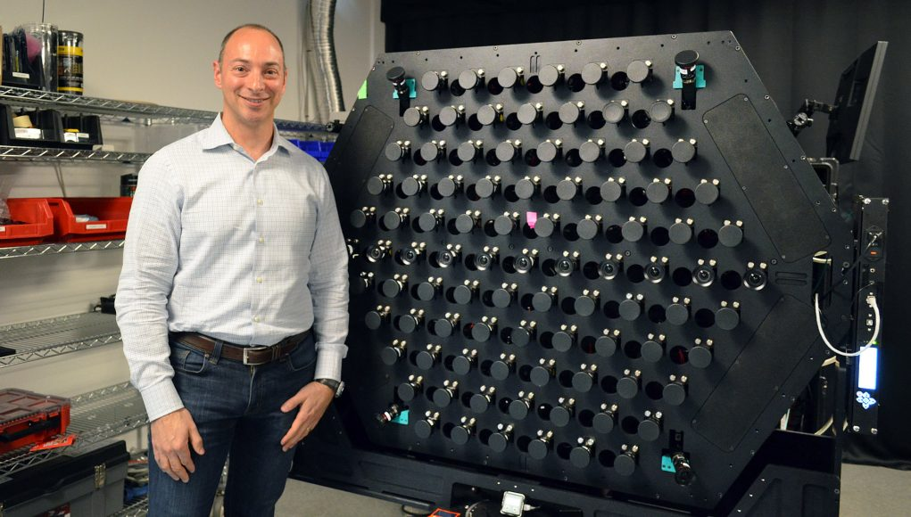
The Pivot and the End
Recognizing that the consumer camera market was a losing battle, Lytro made a dramatic pivot in 2015. They decided to leverage their unique technology for the burgeoning field of Virtual Reality (VR).
Their light-field data, which captured depth and perspective, was perfect for creating immersive, cinematic VR experiences where the viewer could move their head slightly and see around objects naturally (a concept known as six degrees of freedom, or 6DoF).
They announced Lytro Immerge, a colossal, high-end VR video capture camera designed for professional studios. This beast of a machine captured so much data that one second of footage required 400GB of storage and a dedicated server to process it.

Slide 15
The Pivot and the End
While the technology was once again impressive, the ambition was crippling.
The system was impractically large, astronomically expensive (available for rental only), and the market for high-end cinematic VR had not yet matured.
Lytro had once again built a technically brilliant product for a market that wasn't ready or large enough to support it.
After burning through over $200 million in funding, the company could not secure more. In March 2018, Lytro announced it was ceasing operations.
Shortly after, it was reported that Google acquired most of Lytro's assets and many of its engineers for around $40 million—a fraction of the investment poured into it.
Google was primarily interested in the patents and engineering talent to bolster its own efforts in VR and computational photography, which live on in products like the Pixel camera and VR projects.
The story of Lytro is a powerful lesson: groundbreaking technology alone does not guarantee success.
Without the right product-market fit, user experience, and a genuine solution to a widespread problem, even the most magical ideas can fail to find their place in the world.

Slide 16
THANK YOU
Joseph Cijo
2022A7PS0019U

